Slide 1
UHS Vaccination Information Systems
FIVE GUYS - Final Presentation

Slide 2
FIVE GUYS
Akshay Saraf
Pavan Agarwal
Ying-Hsuan Huang
Zijie Wang

Slide 3
01
SYSTEM
UHS Vaccination Information System

Slide 4

Observation and Selection: UHS Vaccination Information System
Key Points:
Successfully operational for 175 years.
Serves students, faculty, and medical personnel.
Manages Immunization programs, ensuring health compliance.

Slide 5
02
PROBLEM
UHS Vaccination Information System

Slide 6


Problems Faced
Time consuming
Too many details

Slide 7
03
SOLUTIONS
UHS Vaccination Information System

Slide 8
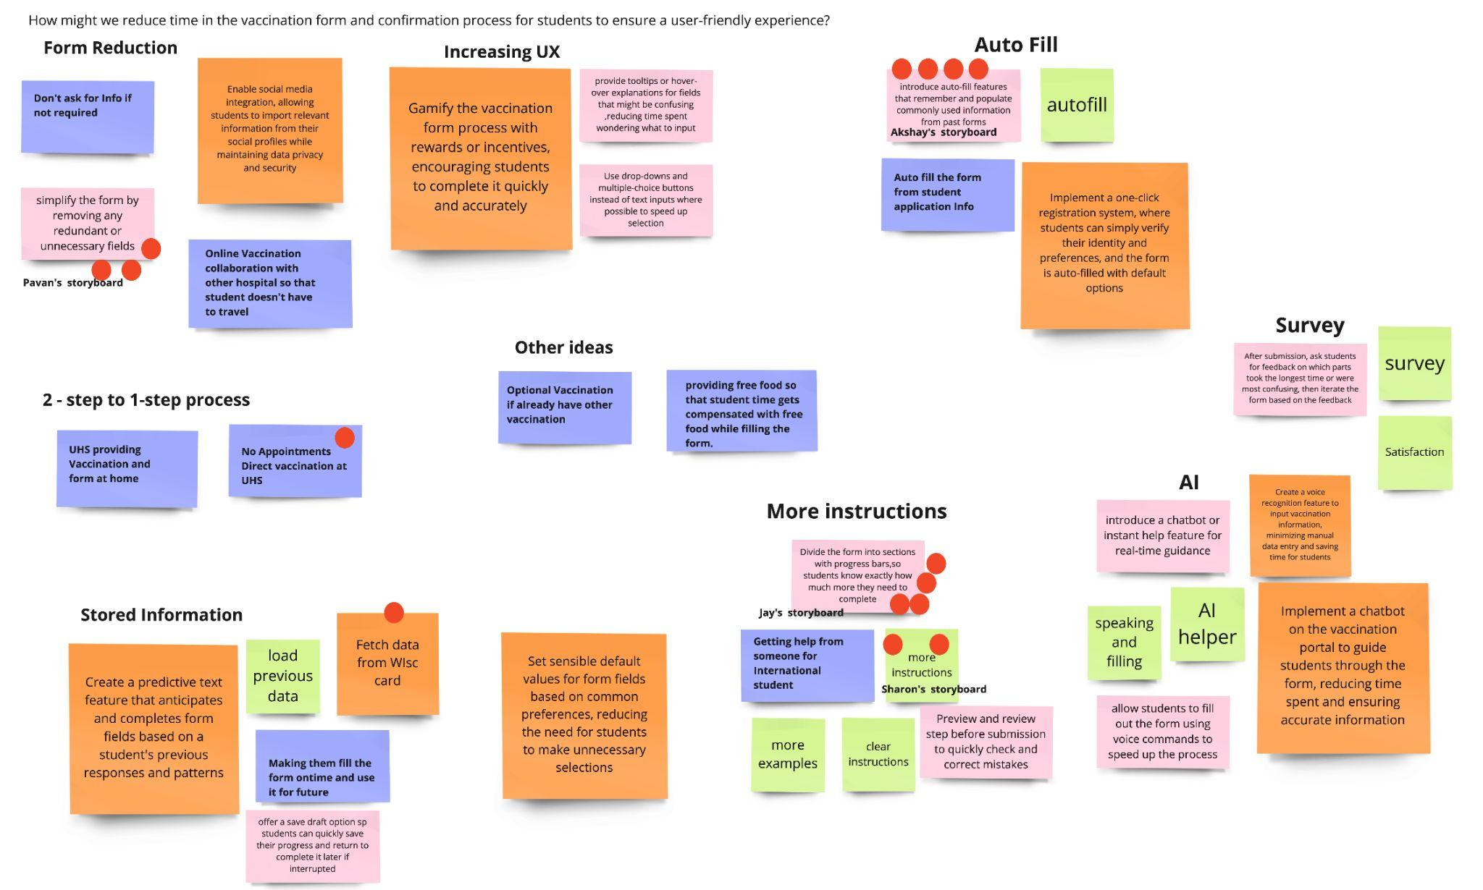
Brainstorming
Auto-Fill
Progress Bar
Form Simplification
Enhanced Instructions

Slide 9
Final Solution:
Auto-Fill + Progress Bar
Fill out information with past data
Dividing the form into sections with visible
progress bar
We can minimize repetitive data entry
We can have clear completion indicator

Slide 10
04
BUSINESS VALUE
UHS Vaccination Information System

Slide 11




Business Value:
Improved User Experience
60% Reduction in Processing Time
Alleviated Administrative Workload
Enhanced Vaccination Participation
Strengthened Reputation and Adherence
Enhanced Data Accuracy and Management

Slide 12
Thank You!
Team Name
Five Guys
Team Members
Akshay Saraf
Pavan Agarwal
Ying-Hsuan Huang
Zijie Wang

